Slide 1

PMIx: A Tutorial
Ralph H. Castain
Intel

Slide 2
Agenda
Day 1: Server & Scheduler
Overview of PMIx
Detailed look at Launch
Day 2: Client, Tools, & Events – Oh My!
Event notification
PMIx Client functions
PMIx Tool support
Notes:
Day 1 will begin with a generalized overview of PMIx that provides some historical context as to the project’s objectives and evolution. This will be followed by a detailed, step-by-step description of the “instant on” launch sequence, including a look at each of the involved APIs, when and how they are used, and their expected behavior.
Day 2 will start with a focused look at the event notification system, a key feature of PMIx that is extensively utilized both internally as well as by many libraries, tools, and applications. This will be followed by a brief overview of the PMIx client functions. Finally, an overview of the PMIx support for tools will complete the tutorial.
Note that Day 2 will be crowded with material, which will limit the degree of detail that can be covered on any one subject. Further tutorials specifically targeting client and tool support are planned for future release.

Slide 3
Terminology
Session
Allocation to a specific user
Job
What was submitted to the scheduler for allocation and execution
Can span multiple sessions
Task
Workflow to be executed within an application
Multiple jobs can coexist within a given session
In MPI terms, a “task” is synonymous with MPI_COMM_WORLD
Application
One or more processes executing the same executable
Can be a script, typically a binary
A single task can be comprised of multiple apps

Slide 4
Day 1: Detail
Overview
PMIx Reference Implementation
Server Initialization
Exercise
Launch Sequence
Exercise
Notes:
This tutorial covers anticipated state of version 4 of the PMIx Standard as expected to be released sometime late 2019. Information pertaining to APIs and behaviors that are new to version 4 (i.e., not present in version 3) will be highlighted.

Slide 5
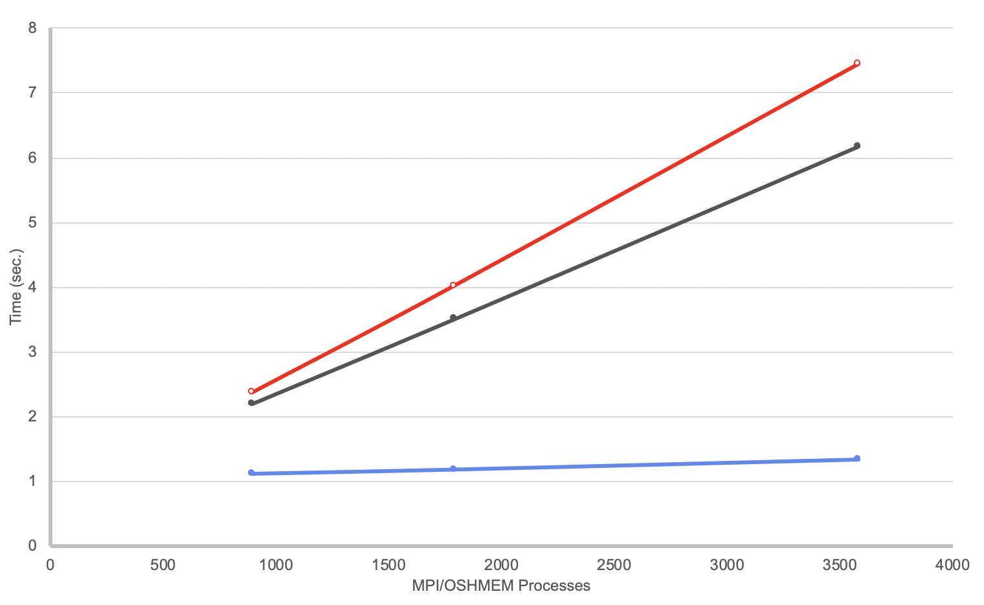










Origin: Changing Landscape
Launch time limiting scale
Programming model &
runtime proliferation
Legion
Hybrid applications
Model-specific tools
Container technologies
Notes:
PMIx originated in the summer of 2014 in response to a variety of problems confronting the system management community:
1. Launch times (defined as the time from user submitting “mpiexec” command – or equivalent – to time when an application completes init and is ready to communicate) on the next generation of large systems were reaching unacceptable levels. Even methods designed to provide logarithmic scaling were resulting in launch times ranging into the 10s of minutes
2. Hybrid applications (apps using more than one programming model library) were growing in popularity and encountering increased problems with conflicts in resource management – e.g., differences in thread binding patterns. This led to unexpected behaviors and user frustration.
3. Programming models are proliferating, many of which include specific workflow requirements built into the model. This includes extension of the HPC environment to support data analytics and AI applications. As a result, new programming models are increasingly accompanied by their own custom runtimes. This creates a lot of unnecessary overhead in exploration of new models and complicates system-level resource management by necessitating allocation of “islands of control”.
4. With the proliferation of programming models, tool vendors (and debuggers in particular) are struggling with the ability to support them as each programming model comes with its own unique mechanism for tool connection and interaction.
5. Growth in popularity of containers raises the issue of interactions between container-internal libraries and external system management components. In addition, moving a container between environments requires that custom configuration code be added to the container so that any external libraries are properly linked to internal libraries that depend upon them

Slide 6
Start Someplace!
Resolve launch scaling
Pre-load information known to RM/scheduler
Pre-assign communication endpoints
Eliminate data exchange during init
Orchestrate launch procedure
Notes:
Faced with the growing range and complexity of the HPC landscape, we decided to begin by addressing the launch time scaling issue. Previous analysis of launch times revealed that most of it was consumed in a global collective exchange of information between the application’s processes, much of that information being already known to the local system management daemon(s). What was lacking was a standardized way of exposing the known information to the application. PMIx set out to provide that mechanism. Once that was available, it became possible to completely eliminate the data exchange and open the door to a more orchestrated launch procedure

Slide 7

Traditional Launch Sequence
GO
Wait for files
& libs
FS
Global
Xchg
Barrier
Job
Script
WLM
WLM
RM
Spawn
Procs
Proc
Proc
Proc
Launch
Cmd
Fabric
Fabric
Fabric
NIC
NIC
NIC
Topo
Topo
Topo

Slide 8
Newer Launch Sequence
GO
Wait for files
& libs
FS
Proxy
Proxy
Proxy
Global
Xchg
Barrier
Spawn
Procs
Proc
Proc
Proc
Job
Script
WLM
WLM
RM
Proc
Proc
Proc
Launch
Cmd
Fabric
Fabric
Fabric
NIC
NIC
NIC
Topo
Topo
Topo

Slide 9
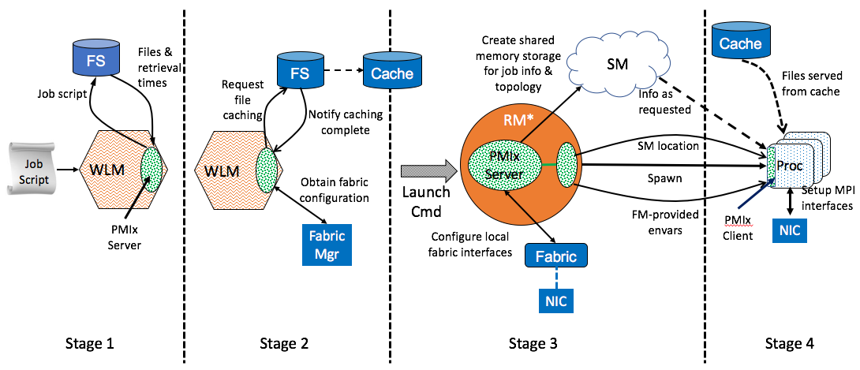
PMIx Launch Sequence
*RM daemon, mpirun-daemon, etc.

Slide 10
Three Distinct Entities
PMIx Standard
Defined set of APIs, attribute strings
Nothing about implementation
PMIx Reference Library
A full-featured implementation of the Standard
Intended to ease adoption
PMIx Reference RTE
Full-featured “shim” to a non-PMIx RM
Provides development environment
v3.1
released!

Slide 11

Where Is It Used?
Libraries
OMPI, MPICH, Intel MPI, HPE-MPI, Spectrum MPI, Fujitsu MPI
OSHMEM, SOS, OpenSHMEM, …
RMs
Slurm, Fujitsu, IBM’s JSM, PBSPro (2019), Kubernetes(?)
Slurm enhancement (LANL/ECP)
New use-cases
Spark, TensorFlow
Debuggers (TotalView, DDT)
MPI
Re-ordering for load balance (UTK/ECP)
Fault management (UTK)
On-the-fly session formation/teardown (MPIF)
Logging information
Containers
Singularity, Docker, Amazon

Slide 12

Build Upon It
Async event notification
Cross-model notification
Announce model type, characteristics
Coordinate resource utilization, programming blocks
Generalized tool support
Co-launch daemons with job
Forward stdio channels
Query job, system info, network traffic, process counters, etc.
Standardized attachment, launch methods
Notes:
With the various subsystems engaged via PMIx for launch support, the natural question became: “what more can we do with these interfaces”? The most frequent request was for a way to provide asynchronous event notifications between the various PMIx participants. This included support for application-generated events as well as system-generated events based on a subscription model.
Once that was accomplished, a working group was formed to look at the hybrid application issues. This WG quickly adopted the event notification system for each model to ”broadcast” (strictly within the process) an alert that it was active within that process. This allowed OpenMP, for example, to alert the MPI library (and vice versa) that they were sharing the process and thus needed to consider how resources were being managed. Subsequently, the WG defined events to coordinate resource assignments and notify the other library when entering/leaving programming blocks requiring more dedicated resources (e.g., higher priority to a dedicated progress thread).
In parallel, another WG began looking at extended support for tools, with a focus on the special needs of debuggers. Historically, debugger vendors were restricted to MPI applications and limited in their interactions due to the specialized MPIR interface. After defining attachment procedures, the WG provided a number of PMIx-based extensions to support scalable operations and enable debuggers to query a wider range of information sources.

Slide 13



Sprinkle Some Magic Dust
Allocation support
Dynamically add/remove/loan nodes
Register pre-emption acceptance, handshake
Dynamic process groups
Async group construct/destruct
Notification of process departure/failure
File system integration
Pre-cache files, specify storage strategies

Slide 14
PMIx-SMS Interactions
System
Management Stack
OpenMP
FS
RM
Fabric
Mgr
Orchestration
Requests
PMIx
Client
PMIx
Server
Fabric
APP
NIC
Responses
MPI
RAS
Job
Script
Tool Support

Slide 15


PMIx-SMS Interactions
System
Management Stack
OpenMP
FS
RM
Fabric
Mgr
Orchestration
Requests
PMIx
Client
PMIx
Server
Fabric
APP
NIC
Responses
MPI
RAS
Job
Script
Container!
Tool Support

Slide 16
Philosophy
Generalized APIs
Few hard parameters
“Info” arrays to pass information, specify directives
Easily extended
Add “keys” instead of modifying API
Async operations
Thread safe

Slide 17
Guiding Principles
Messenger, not a Doer
There are some (very limited) exceptions
No internal inter-node messaging support
Per RM request, all inter-node messaging provided by host environment
Minimizes connections and avoids yet another wireup procedure
Host environment required to know where things are
Where to send requests based on PMIx server type, info on a given proc
“Not Supported”
Critical to RM adoption
Let the market drive support

Slide 18
“Doer” Exceptions
Interactions with non-PMIx systems
Fabric manager, credential subsystems, storage systems
Aggregate local collective operations
Fence, connect/disconnect
Environment “support”
Inventory collection, process monitoring, logging

Slide 19
PMIx Scope
Wireup
Fence, put, get, commit
Publication
Publish, lookup, unpublish
Dynamics
Spawn, connect, disconnect, group construct/destruct
Storage
Estimate retrieval times, set hot/warm/cold policy, data movement
WLM
Inventory, comm costs, subsystem app resource allocations, allocation mgmt
Fabric
QoS control, async updates
Tools
Query, attach/detach, IO fwd
Events (Async notification)
Info
Query, logging

Slide 20



WLM/RTE Orchestrator
Network
File
System
Resource
Manager
WLM
APP
Prov. Agent
Monitoring
Console
DB

Slide 21
Day 1: Detail
Overview
PMIx Reference Implementation
Server Initialization
Exercise
Launch Sequence
Exercise

Slide 22
Reference Implementation
https://github.com/pmix/pmix
Objective
Ease adoption, validate proposed standard modifications/additions
Written in C with some C++ like extensions (object classes)
Plugin architecture
Internal APIs defined as “frameworks” with individual ”component” implementations
Components loaded as dll’s to allow for proprietary add-ons
Python bindings
Utilize public PMIx APIs (not internal)
Debugging fundamentals - Verbosity is your friend
Framework level spans components (e.g., ptl_base_verbose)
No separation between client and server
Functional level (pmix_iof_xxx_verbose), where xxx is either “client” or “server”

Slide 23
Releases
RM Production Releases
1/2016
12/2016
12/2017
12/2018
12/2019
2014
1.1.3
1.2
2.0
3.0
4.0
Launch &
wireup
Events, fabric, & basic tool
Logging, IO fwd, credentials, inventory, job ctrl, monitoring,
dyn alloc
Scheduler, groups, storage, adv tools, Python
major.minor.release
Standard
version
https://github.com/pmix/pmix/releases

Slide 24
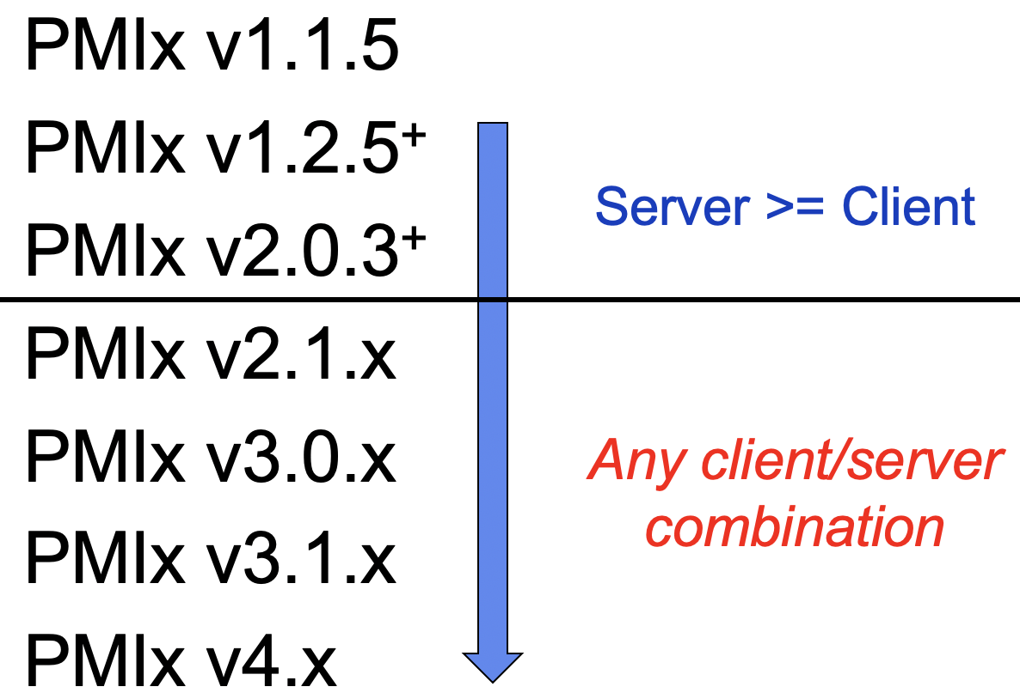
Cross-Version Support
Auto-negotiate messaging protocol
Client starts
Envar indicates server capabilities
Select highest support in common
Convey selection in connection handshake
Server follows client’s lead
Per-client messaging protocol
Support mix of client versions
+
+
Done!

Slide 25
Process Types
Client
Application process connected to local server
Server
Client + server APIs + host function module
Subtypes: gateway, scheduler, default
Tool
Client APIs with rendezvous
Launcher
Tool + server APIs

Slide 26
Day 1: Detail
Overview
PMIx Reference Implementation
Server Initialization
Exercise
Launch Sequence
Exercise

Slide 27
Server Initialization
Declare server type
Gateway: acts as a gateway for PMIx requests that cannot be serviced on backend nodes (e.g., logging to email)
Scheduler: supports inventory and application resource allocations
Default: supports local PMIx clients and possibly tools
Setup internal structures
Create rendezvous file(s) for tool support
Note: servers have access to all client, tool functions

Slide 28
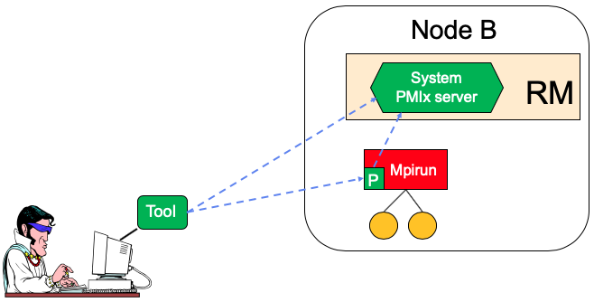
Rendezvous File Locations
System TMPDIR
pmix.sys.host
Server TMPDIR
(per nspace)
pmix.host.tool.nspace
pmix.host.tool.pid
pmix.host.tool
rndvsFile
PRRTE demo

Slide 29
Server: Initialization Options
PMIx_server_init(pmix_server_module_t *module,
pmix_info_t info[], size_t ninfo)
Process ID, system and server tmpdir
Accept tool connections?
Act as “system server” on that node?
Server backend function module
Can be NULL or empty

Slide 30
Server Function Pointer Module
Struct of function pointers (currently 26)
Provide access to host environment operations, info
Request support for inter-node ops
NULL or omitted => no support for that function
Return rules
PMIX_SUCCESS: request accepted, cbfunc executed when complete
Cbfunc cannot be called prior to return from function
PMIX_OPERATION_SUCCEEDED: operation completed and successful, cbfunc will not be called
PMIx error code: problem with request, cbfunc will not be called

Slide 31
Module Functions
const pmix_proc_t *proc, void* server_object,
pmix_op_cbfunc_t cbfunc, void *cbdata)
Client_connected
Client has connected to server, passing all internal security screenings
Matches expected uid/gid, psec plugin checks
Server response: indicate if connection is okay, host support ready
Client_finalized
Client has called PMIx_Finalize
Server response: allow client to leave PMIx
const pmix_proc_t *proc, void* server_object,
pmix_op_cbfunc_t cbfunc, void *cbdata)

Slide 32
Module Functions
const pmix_proc_t *proc, void *server_object, int status, const char msg[],
pmix_proc_t procs[], size_t nprocs, pmix_op_cbfunc_t cbfunc, void *cbdata
Abort
Client requests that specified procs be terminated and provided status/msg be reported to user
NULL proc array => all members of requestor’s nspace
Request does not automatically include requestor
Fence_nb
Execute inter-node barrier collecting any provided data
Array of participating procs indicates which nodes will participate
Host required to translate proc to node location
Forms op signature: multiple simultaneous ops allowed, only one per sig
Return all collected data to each participating server
const pmix_proc_t procs[], size_t nprocs, const pmix_info_t info[], size_t ninfo,
char *data, size_t ndata, pmix_modex_cbfunc_t cbfunc, void *cbdata

Slide 33
Module Functions
Direct_modex
Provide job-level data for nspace if rank=wildcard
Request any info “put” by the specified proc
Host required to:
Identify node where proc located
Pass request to PMIx server on that node
Return data response back to requesting PMIx server
const pmix_proc_t *proc, const pmix_info_t info[], size_t ninfo,
pmix_modex_cbfunc_t cbfunc, void *cbdata

Slide 34
Module Functions
const pmix_proc_t *source, const pmix_info_t info[], size_t ninfo,
pmix_op_cbfunc_t cbfunc, void *cbdata
Publish
Publish information from source
Info array contains info + directives (range, persistence, etc.)
Duplicate keys in same range = error
Lookup
Retrieve info published by publisher for provided keys (NULL -> all)
Info array contains directives (range)
Unpublish
Delete data published by source for provided keys (NULL -> all)
Info array contains directives (range)
const pmix_proc_t *proc, char **keys, const pmix_info_t info[], size_t ninfo,
pmix_lookup_cbfunc_t cbfunc, void *cbdata
const pmix_proc_t *proc, char **keys, const pmix_info_t info[], size_t ninfo,
pmix_op_cbfunc_t cbfunc, void *cbdata

Slide 35
Module Functions
const pmix_proc_t procs[], size_t nprocs, const pmix_info_t info[], size_t ninfo,
pmix_op_cbfunc_t cbfunc, void *cbdata
Connect
Record specified procs as “connected”
Treat failure of any proc as reportable event
Collective operation
Array of procs => operation signature
Multiple simultaneous ops allowed, only one per signature
Disconnect
Separate specified procs
Collective operation
Array of procs => operation signature
Multiple simultaneous ops allowed, only one per signature
const pmix_proc_t procs[], size_t nprocs, const pmix_info_t info[], size_t ninfo,
pmix_op_cbfunc_t cbfunc, void *cbdata

Slide 36
Module Functions
pmix_status_t *codes, size_t ncodes, const pmix_info_t info[], size_t ninfo,
pmix_op_cbfunc_t cbfunc, void *cbdata
Register_events
Request host provide notification of specified event codes using PMIx_Notify_event API
NULL => all
Deregister_events
Stop notifications for specified events
NULL => all
Notify event
Request host notify all procs (within specified range) of given event code using PMIx_Notify_event
pmix_status_t *codes, size_t ncodes,
pmix_op_cbfunc_t cbfunc, void *cbdata
MORE ON
DAY2!
pmix_status_t code, const pmix_proc_t *source,
pmix_data_range_t range, pmix_info_t info[], size_t ninfo,
pmix_op_cbfunc_t cbfunc, void *cbdata

Slide 37
Module Functions
const pmix_proc_t *proc, const pmix_info_t job_info[], size_t ninfo,
const pmix_app_t apps[], size_t napps,
pmix_spawn_cbfunc_t cbfunc, void *cbdata
Spawn
Launch one or more applications on behalf of specified proc
Job-level directives apply to all apps, info provided to all procs
App-specific directives included in app object, info provided solely to app’s procs
Can include allocation directivces
Listener
Host shall monitor provided socket for connection requests, harvest/validate them, and call cbfunc for PMIx server to init client setup
int listening_sd, pmix_connection_cbfunc_t cbfunc, void *cbdata

Slide 38
Module Functions
Query
Request information from the host environment (e.g., queue status, active nspaces, proc table, time remaining in allocation)
Tool_connected
Tool has requested connection to server
Info contains uid/gid of tool plus optional service requests
Host can validate request, return proc ID for tool
pmix_proc_t *proct, pmix_query_t *queries, size_t nqueries,
pmix_info_cbfunc_t cbfunc, void *cbdata
pmix_info_t *info, size_t ninfo,
pmix_tool_connection_cbfunc_t cbfunc, void *cbdata

Slide 39
Module Functions
Log
Push the specified data to a persistent datastore or channel per directives
Syslog, email, text, system job log
Allocate
Request modification to existing allocation
Extension (both time and resource), resource release, resource “lend”/”callback”
Request new allocation
const pmix_proc_t *client, const pmix_info_t data[], size_t ndata,
const pmix_info_t directives[], size_t ndirs, pmix_op_cbfunc_t cbfunc, void *cbdata
const pmix_proc_t *client, pmix_alloc_directive_t directive,
const pmix_info_t data[], size_t ndata,
pmix_info_cbfunc_t cbfunc, void *cbdata

Slide 40
Module Functions
Job_control
Signal specified procs (pause, resume, kill, terminate, etc.)
Register files/directories for cleanup upon termination
Provision specified nodes with given image
Direct checkpoint of specified procs
Monitor
Monitor this process for ”signs of life”
File (size, access, modify), heartbeat, etc.
Failures reported as PMIx events
const pmix_proc_t *requestor, const pmix_proc_t targets[], size_t ntargets,
const pmix_info_t directives[], size_t ndirs, pmix_info_cbfunc_t cbfunc, void *cbdata
const pmix_proc_t *requestor, const pmix_info_t *monitor, pmix_status_t error,
const pmix_info_t directives[], size_t ndirs, pmix_info_cbfunc_t cbfunc, void *cbdata

Slide 41
Module Functions
Get_credential
Request a credential
Validate_credential
Validate a credential
Group
Perform a barrier op across specified procs
Perform any host tracking/cleanup operations
Return result of any special requests in directives
Assign unique context ID to group
const pmix_proc_t *proc, const pmix_info_t directives[], size_t ndirs,
pmix_credential_cbfunc_t cbfunc, void *cbdata
const pmix_proc_t *proc, const pmix_byte_object_t *cred,
const pmix_info_t directives[], size_t ndirs,
pmix_validation_cbfunc_t cbfunc, void *cbdata
pmix_group_operation_t op, char grp[], const pmix_proc_t procs[], size_t nprocs,
const pmix_info_t directives[], size_t ndirs, pmix_info_cbfunc_t cbfunc, void *cbdata

Slide 42
Module Functions
const pmix_proc_t procs[], size_t nprocs, const pmix_info_t directives[], size_t ndirs,
pmix_iof_channel_t channels, pmix_op_cbfunc_t cbfunc, void *cbdata
IOF_pull
Request the specified IO channels be forwarded from the given array of procs to this server for local distribution
Stdin is not supported in this call
Push_stdin
Request the host transmit and deliver the provided data to stdin of the specified targets
Wildcard rank => all procs in that nspace
Source identifies the process whose stdin is being forwarded
const pmix_proc_t *source, const pmix_proc_t targets[], size_t ntargets,
const pmix_info_t directives[], size_t ndirs, const pmix_byte_object_t *bo,
pmix_op_cbfunc_t cbfunc, void *cbdata

Slide 43
Exercise 1: Create a Server
Python or C – your choice
Initialize a server
Start with an empty server module
Specify a “safe” tmpdir location
Indicate it should be a “system” server
Have it hang around
Use “pattrs” to find out what it supports
Add job_control function to server module
Have it cause your server to exit
Use PRRTE’s ”prun --terminate” to trigger it

Slide 44
Day 1: Detail
Overview
PMIx Reference Implementation
Server Initialization
Exercise
Launch Sequence
Exercise

Slide 45
Stage 0: Inventory Collection
Objective
Gather a complete picture of all relevant hardware in the system
Utilizes HWLOC to obtain information
Allow each plugin to extract what is relevant to it
Fabric – NICs/HFIs plus distance matrix; topology, connectivity, and per-plane communication costs
Memory – available memory and hierarchy
Two collection modes

Slide 46
Relevant Functions
PMIx_server_collect_inventory
Collect inventory of local resources
Pass opaque blob back to host for transmission to WLM-based server
Info keys can specify types/level of detail of inventory to collect
PMIx_server_deliver_inventory
Pass inventory blobs into PMIx server library for processing
Construct internal resource trackers
pmix_info_t directives[], size_t ndirs,
pmix_info_cbfunc_t cbfunc, void *cbdata
pmix_info_t info[], size_t ninfo,
pmix_info_t directives[], size_t ndirs,
pmix_op_cbfunc_t cbfunc, void *cbdata

Slide 47
Mode 1: Rollup
RM
Daemon
PMIx_server_collect_inventory
(default to local only)
Inventory blob
HWLOC
Probe local
inventory
Filter thru
plugins
Extract NIC,
memory info, etc

Slide 48
Mode 1: Rollup
“phone home”
WLM
RM
Daemon
PMIx_server_collect_inventory
(local+infra)
PMIx_server_deliver_inventory
PMIx_server_collect_inventory
(default to local only)
Inventory blob
Obtain switch,
connectivity,
topology info
Construct internal
resource trackers
(plugins)
HWLOC
FM
Probe local
inventory
Filter thru
plugins
Extract NIC,
memory info, etc

Slide 49
Mode 2: Central
WLM
Only collects inventory accessible via centralized source (e.g., FM)
Option: WLM can request remote daemons respond with their local inventory
PMIx_server_collect_inventory
(global)
Obtain NIC, switch,
connectivity,
topology info
FM
Construct internal
resource trackers
(plugins)

Slide 50
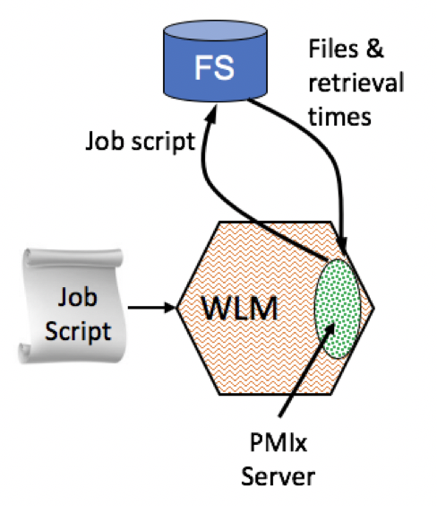
Stage 1: Scheduling
Storage timing
Identify dependencies
Estimate caching/retrieval times
Fabric considerations
Access relative communication costs
Asynchronously updated by FM events
Capabilities of each plane
Map user requests vs available planes

Slide 51
Baseline Storage Vision
Tiered storage
Parallel file system
Caches at IO server, switches, cabinets, …
Caches hold images, files, executables, libraries, checkpoints
Bits flow in all directions
Stage locations prior to launch
Movement in response to faults, dynamic workflow, computational stages

Slide 52
Estimate Retrieval Times
Parse for dependencies
(plugins)
Current data map
Usage patterns
Authorization
WLM
Query
User-specified caching, dependencies
(data & libs), persistence
Retrieval time
Job
Script

Slide 53
Relevant Storage Functions
(signatures TBD)
Dependencies
Support multiple methods via plugins
Typical ldd-like checks, others are active area of research
Accessibility
List of files and uid/gid or credential, return accessibility status for each file
Include temperature/location (e.g., hot/cached, warm/on disk), other metadata
Scheduling data
Time/cost to move specified files to given target locations (nodes, caches, temp)
Info queries
Available storage, unit of reservation (block size)
Storage strategies (striping patterns)
Capabilities (QoS levels, bandwidth, topology, co-located processes)

Slide 54
Relevant Fabric Functions
PMIx_server_register_fabric
Obtain a handle to a specific fabric plane
Can specify plane by characteristics or name
Obtain available names via PMIx_Query
Pmix_server_deregister_fabric
Release the fabric handle
Terminology
Vertex: NIC or switch interface, can include metadata
Index: column or row in the cost matrix
pmix_fabric_t *fabric,
const pmix_info_t directives[], size_t ndirs
pmix_fabric_t *fabric
Correspondence changes as interfaces fail, go offline, return as entire cost matrix is updated by FM!

Slide 55
Dealing With Updates
Fabric plane handle tracks revision
Matrix updates
Occur in thread-safe event
Increment matrix revision
Functions that access cost data
Execute in thread-safe event
Check handle version against matrix version
Return PMIX_FABRIC_UPDATED if mismatch
PMIx_server_update_fabric
Syncs version level of handle to matrix
pmix_fabric_t *fabric

Slide 56
Relevant Fabric Functions
PMIx_server_get_num_vertices
Get number of vertices in the provided fabric plane
PMIx_server_get_comm_cost
Obtain relative communication cost for sending message from src to dest across provided plane
PMIx_server_get_vertex_info
Given index, get interface metadata and name of node/switch hosting it
PMIx_server_get_index
Given vertex, get matrix index and name of node/switch hosting it
pmix_fabric_t *fabric, uint32_t *nverts
pmix_fabric_t *fabric,
uint32_t src, uint32_t dest, uint16_t *cost
pmix_fabric_t *fabric, uint32_t i,
pmix_value_t *vertex, char **nodename
pmix_fabric_t *fabric, pmix_value_t *vertex,
uint32_t *i, char **nodename
Open issue: query/return blocks of results – e.g., “give me 100 nodes with minimum relative comm cost”? May prove too complex a query due to number of constraint options.

Slide 57
Exercise 2: Scheduler Support
Extend your previous server using the ”test” fabric component
PMIX_MCA_pnet=test
PMIX_MCA_pnet_test_nverts=nodes:5;plane:d:3
Collect the inventory
How many NICs are in the system?
Print the communication costs between them
What vertex info is available for index 3?
What is the index of the 1st NIC on node “test001”?

Slide 58
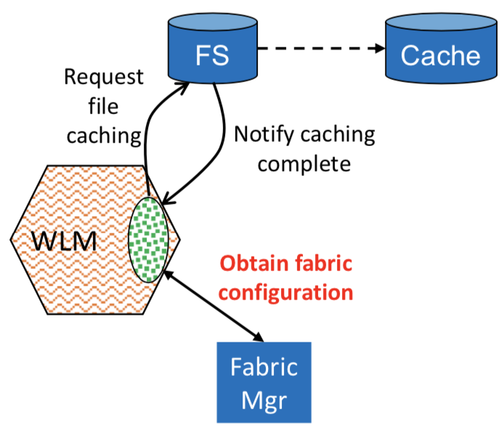
Stage 2: Launch Prep
Storage requests
Request pre-position/cache data
Allocate storage resources
Fabric requests
Obtain fabric info for application
Endpoints, network coordinates, etc.
Set fabric configuration
Software-defined topologies, QoS, etc.
Obtain security credentials
Collect envars to forward
Obtain/set fabric configuration

Slide 59
Storage Directives
(signatures TBD)
Shift data
Move cache to parallel file system to clear room
Pre-position data from file system to cache
Gateway, network-near target nodes, on-node bulk memory
Async operation – callback upon completion
Allocate storage resources
Manage cache allotments
Set storage strategy for job

Slide 60
Data Mover
fork/exec
Gateway Node
Lustre
WLM
System
PMIx server
User
DM
Data movement directives
Cache
Job
Script

Slide 61
Setup Application
const pmix_nspace_t nspace, pmix_info_t info[], size_t ninfo,
pmix_setup_application_cbfunc_t cbfunc, void *cbdata
PMIx_server_setup_application
Process mapping: What procs are on which nodes and where they are bound
Any directives regarding fabric settings (e.g., planes to be used, QoS), others
Cycle across active components
Fabric plugins
Assign endpoints: info directives indicate how many per plane to assign to each proc, assignments provided in order of closest NIC to proc
Generate fabric credential(s) for job
Collect fabric-specific envars and settings for client libraries/drivers
Storage plugins
Alert job starting, retrieve storage settings for client libraries/drivers
Pickup PMIx-specific envars
Return info array for delivery to compute nodes

Slide 62
What About mpiexec?
Launch its daemons on all nodes
Collect inventory from each
Proceed as before
If inventory not available
PMIx_server_setup_application automatically requests info from scheduler
Provide URI for scheduler PMIx server
“Upcall” to RM for transmission

Slide 63
Exercise 3: Launch Prep
Extend your previous server
PMIX_MCA_pnet=test
PMIX_MCA_pnet_test_nverts=nodes:5;plane:d:3
Define an application (keep it simple)
Hosts: “test000,test001,test002”
Ppn: “0,1,2;3,4,5;6,7”
Remember to use the regex generators!
Setup the application
Allocate network resources and security key
Pickup all related envars
Use the PNET verbosity parameter to see what it is doing
Print out the result

Slide 64
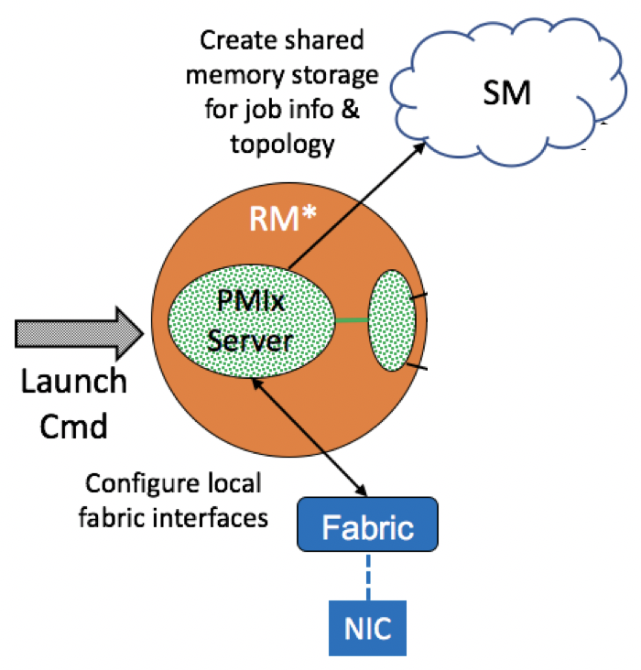
Stage 3: Local Spawn Prep
Extract setup array from launch msg
Check for job-level directives
Modify paths, set/unset envars
PMIx_server_setup_local_support
Pass input to all active components
Fabric plugins
Setup local drivers, prep address tables, …
Storage plugins
Setup local drivers, configure memory, …
PMIx_server_register_nspace
Pass in job- and proc-level info for clients
Include setup array info, process map
const pmix_nspace_t nspace,
pmix_info_t info[], size_t ninfo,
pmix_op_cbfunc_t cbfunc, void *cbdata
const pmix_nspace_t nspace, int nlocalprocs,
pmix_info_t info[], size_t ninfo,
pmix_op_cbfunc_t cbfunc, void *cbdata

Slide 65
Stage 4: Fork/Exec
PMIx_server_register_client
Register each local proc for this nspace
Informs server of expected uid/gid of connecting client for security check
Server preps client support infrastructure
PMIx_server_setup_fork
Add PMIx server connection and support info to env
Add subsystem-specific envars for client libraries (e.g., fabric, storage)
const pmix_proc_t *proc, uid_t uid, gid_t gid,
void *server_object, pmix_op_cbfunc_t cbfunc, void *cbdata
const pmix_proc_t *proc, char ***env

Slide 66
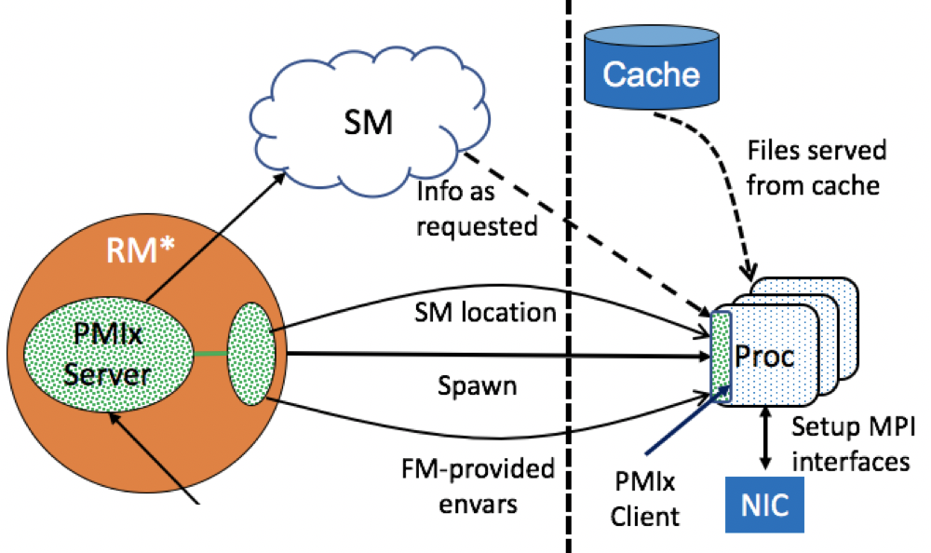
Stage 5: Process Startup
Handshake with server
Sets compatibility plugins
Server function module
Given chance to validate or
reject connecting client
Transfer data to client
Setup SM datastore
Send copy to client

Slide 67
Exercise 4: Fork/Exec Prep
Extend your previous server
Setup the local support
Pass in the data returned by setup application
Use the GDS and PNET verbosity parameters to see what it is doing
Register the nspace
For now, just pass universe size and 3 local procs
Register the local clients
Setup the fork environment for each client
Print out the results

Slide 68
Stage 6: Process Termination
PMIx_server_deregister_client
Called when local client terminates
Often called from within function module client_terminated entry
Both normal and abnormal termination
Provides server library with chance to cleanup
Generate event
Abnormal termination only to avoid floods
Typically only upon request included with spawn directives
Notify anyone listening for PMIX_PROC_ABORTED event
Provide ID of affected proc, any provided text message and/or info
Target only nspace of affected proc unless otherwise directed
Target non-default handlers
const pmix_nspace_t nspace,
pmix_op_cbfunc_t cbfunc, void *cbdata

Slide 69
Stage 7: Job Termination
PMIx_server_deregister_nspace
Called when job completes
Note: PMIx cannot provide function module entry as it doesn’t see multi-node job status
Provides server library with chance to cleanup
Generate event
Notify anyone listening for PMIX_JOB_TERMINATED event
Optional to perform by default
Target non-default handlers
Provide exit status, any associated text message and/or info

Slide 70
Day 1: Detail
Overview
PMIx Reference Implementation
Server Initialization
Exercise
Launch Sequence
Exercise

Slide 71
Exercise: Scheduler
Extend your server to support a scheduler
Collect local inventory
Poke around the comm cost matrix
Perhaps with ”pquery” tool?
Define an application and set it up
Set pnet_base_verbose=100 to see what it does

Slide 72
Agenda
Day 1: Server & Scheduler
Overview of PMIx
Detailed look at Launch
Day 2: Client, Tools, & Events – Oh My!
Event notification
PMIx Client functions
PMIx Tool support
Notes:
Day 1 will begin with a generalized overview of PMIx that provides some historical context as to the project’s objectives and evolution. This will be followed by a detailed, step-by-step description of the “instant on” launch sequence, including a look at each of the involved APIs, when and how they are used, and their expected behavior.
Day 2 will start with a focused look at the event notification system, a key feature of PMIx that is extensively utilized both internally as well as by many libraries, tools, and applications. This will be followed by a brief overview of the PMIx client functions. Finally, an overview of the PMIx support for tools will complete the tutorial.
Note that Day 2 will be crowded with material, which will limit the degree of detail that can be covered on any one subject. Further tutorials specifically targeting client and tool support are planned for future release.

Slide 73
Events
Async notification
Proc failures, system issues, coordination requests, workflow orchestration
Types of events
Job-specific: directly relate to executing job
Debugger attachment, proc failure, app-generated event
Always delivered to the PMIx server by host
Environment: indirectly relate to a job but not specifically targeting it
ECC errors, temperature excursions, …
Delivered only upon request to host
Event codes
Any integer value
Host-specific values must be either positive or lie beyond PMIX_EXTERNAL_ERR_BASE

Slide 74
Registration
Anyone can register
Host subsystem elements, apps, tools
PMIx_Register_event_handler
Specify any number of codes (3 categories)
NULL => default handler for all codes
Single code, Multiple codes
Can provide string name for this handler
Used for ordering and debugging
Callback returns handler registration ID (deregister, returned in notifications)
Handlers not required to be unique (can register same function multiple times)
Event caching
Job-specific events required to be cached and delivered in order
Environment events are requested to be cached
pmix_status_t codes[], size_t ncodes,
pmix_info_t info[], size_t ninfo,
pmix_notification_fn_t evhdlr,
pmix_hdlr_reg_cbfunc_t cbfunc,
void *cbdata

Slide 75
Handler Directives
Specify ordering at time of registration
First => execute this handler before any others*
Last => execute this handler after all others have completed*
First in category => execute this handler before any others for the event category*
Last in category => execute after all handlers for the event category have completed*
Before – insert immediately before the named handler
After – insert immediately after the named handler
Prepend – add to the front of the list for this category
Append – add to the end of the list for this category
Restrict interest
Pass array of specific affected procs we want to hear about
Events impacting all other procs will be ignored for that handler
*only one of each

Slide 76
Handler Signature
ID of handler being called
Event code
size_t evhdlr_registration_id,
pmix_status_t status,
const pmix_proc_t *source,
pmix_info_t info[], size_t ninfo,
pmix_info_t *results, size_t nresults,
pmix_event_notification_cbfunc_fn_t cbfunc,
void *cbdata);
Info provided by source
Proc that generated event
Aggregate of results from all prior handlers
Handler return code
pmix_status_t status,
pmix_info_t *results, size_t nresults,
pmix_op_cbfunc_t cbfunc, void *thiscbdata,
void *notification_cbdata
Array of results from this handler
Callback fn/data to release handler data

Slide 77
Generation
Anyone can generate an event
Application procs, tools, host
PMIx_Notify_event
Report a single event code plus source that generated the event
Specify a delivery range
RM: solely to the host
Local: available to procs on local node only
Namespace: available to procs in same nspace only
Session: available to procs in same session only
Global: available to all procs
Proc_local: available only internally to the generating proc
Custom: array of specific target procs
Provide additional info
Affected proc(s), do not deliver to default event handlers
pmix_status_t status,
const pmix_proc_t *source,
pmix_data_range_t range,
const pmix_info_t info[], size_t ninfo,
pmix_op_cbfunc_t cbfunc, void *cbdata

Slide 78
Event Handling
Precedence order
First
Single code -> Multi-code -> Default handlers
First/last called in each category
Last
Results “chained”
Results returned by each handler are added to end of results array passed to next handler
Each handler must call event handler completion function
All processing stops upon return of PMIX_EVENT_ACTION_COMPLETE
Not allowed to perform any blocking operation during handler

Slide 79
Event Notes
Last handler is called after all registered default handlers matching specified range
Ensure no default handler aborts process before it
Events cannot be delivered back to the process that generated them
Host cannot pass event back to its PMIx server library
Server library cannot pass event back to generating client
Keep event handlers short
PMIx server library is “blocked” until completion

Slide 80
Event Processing
RM
RM
PMIx
Server
PMIx
Server
chain
chain
Send and then internally process
chain
chain

Slide 81
Example Uses
Hybrid applications
Notify programming libraries of each others existence, operations
OpenMP + MPI: coordinate programming blocks
Notification strictly within the individual proc
Fault tolerance: ULFM
Notification of process failure
Tools
Notification of job completion
Debugger attachment handshake

Slide 82
Query App Info
RM
RM
PMIx
Server
PMIx
Server
Query
Query
mpiexec
mpid
PMIx
Server
PMIx
Server
Dbgr
Dmn
App query event
Proc
Proc
Register handler for event

Slide 83
Agenda
Day 1: Server & Scheduler
Overview of PMIx
Detailed look at Launch
Day 2: Client, Tools, & Events – Oh My!
Event notification
PMIx Client functions
PMIx Tool support
Notes:
Day 1 will begin with a generalized overview of PMIx that provides some historical context as to the project’s objectives and evolution. This will be followed by a detailed, step-by-step description of the “instant on” launch sequence, including a look at each of the involved APIs, when and how they are used, and their expected behavior.
Day 2 will start with a focused look at the event notification system, a key feature of PMIx that is extensively utilized both internally as well as by many libraries, tools, and applications. This will be followed by a brief overview of the PMIx client functions. Finally, an overview of the PMIx support for tools will complete the tutorial.
Note that Day 2 will be crowded with material, which will limit the degree of detail that can be covered on any one subject. Further tutorials specifically targeting client and tool support are planned for future release.

Slide 84
PMIx Scope: Client
Wireup
Fence, put, get, commit
Publication
Publish, lookup, unpublish
Dynamics
Spawn, connect, disconnect, group construct/destruct
Storage
Estimate retrieval times, set hot/warm/cold policy, data movement
WLM
Inventory, comm costs, subsystem app resource allocations, allocation mgmt
Fabric
QoS control, async updates
Tools
Query, attach/detach, IO fwd
Events (async notification)
Info
Query, logging

Slide 85
Wireup
pmix_scope_t scope,
const pmix_key_t key,
pmix_value_t *val
const pmix_proc_t procs[], size_t nprocs,
const pmix_info_t info[], size_t ninfo
PMIx_Put
Adds provided key-value pair to internal cache
Duplicate keys are overwritten
PMIx_Commit
Sends all added/modified key-value pairs since last commit to local PMIx server
Server required to store keys on per-proc basis – i.e., procs can post the identical key without overwrite
Fence
Barrier operation
Data collection optional
Get
Retrieve key for a given proc
PMIX_RANK_UNDEF: retrieve globally unique key (legacy support)
Check internal/shmem first
Request from server
Obtain from remote server hosting specified proc if data not exchanged
const pmix_proc_t *proc, const char key[],
const pmix_info_t info[], size_t ninfo,
pmix_value_t **val

Slide 86
Key-Value “Scope”
Who can “Get” this key-value pair?
Specified by source process at time of “put”
Controls access by other procs
“internal”: only available to the source proc
”local”: only accessible by other procs on same node
“remote”: only available to procs on other nodes
“global”: available to everyone
Only remote and global scope included in data exchanges during “fence”

Slide 87
Publication
PMIx_Publish
Publish data in info array to specified range (default: session)
Keys must be unique within given range
Not indexed by source proc!
First published “wins” – followers return error
Persistence instructs server as to how long data is retained (default: app)
PMIx_Unpublish
Delete data for specified keys
NULL => delete all data published by this process
PMIx_Lookup
Retrieve published data
Constrained to data published by current uid/gid
Returns error if not found
Optional: wait for first found data, wait for all data, timeout
“non-found” data will have PMIX_UNDEF datatype
const pmix_info_t info[], size_t ninfo
pmix_pdata_t data[], size_t ndata,
const pmix_info_t info[], size_t ninfo
char **keys,
const pmix_info_t info[], size_t ninfo

Slide 88
Range & Persistence
Range: who has access to data
“proc_local”: only within the proc itself (e.g., across threads)
”local”: only procs on local node
“namespace”: only procs within same nspace (job) as publisher
“session”: only procs within same session (allocation) as publisher
“global”: any process
“custom”: only specified processes
“rm”: only the host environment
Persistence: when data shall automatically be deleted
“first_read”: delete after first access
“proc”: retain until publisher terminates
“app”: delete when publisher’s application terminates
“namespace”: delete when publisher’s nspace (job) terminates
“session”: delete when publisher’s session (allocation) terminates
“indef”: retain until specifically deleted

Slide 89
Dynamics: Basic
Spawn
Spawn new job
Job_info specifies directives and info for all apps
Apps array contains info for each individual app
Namespace returned upon spawn complete
Variety of notification options
Job launched, job terminated, app terminated, proc terminated
Connect
Mark the specified procs as “connected”
All procs to receive
Job-level info for nspaces of all participants
“put” info from participants, filtered by scope
Disconnect
Remove “connected” specification for given procs
Return error if not connected

Slide 90
Dynamics: Groups vs Basic
Relation to RM
Connect: passed to RM, no new ID assigned
Group: handled by PMIx server, each proc assigned new “group rank”, translate group IDs to global IDs for RM operations
Construction
Connect: bulk synchronous only
Group: can be dynamic, invite/join as well as nonblocking
Destruction
Disconnect: bulk synchronous only
Group: can be dynamic, members notified as procs leave

Slide 91
Allocation Management
PMIx_Allocation_request
Request allocation of new resources
Extend current reservation on specified resources
Release current specified resources
“Lend” resources back, mark for return on request or after specified time
Return requested by passing PMIX_ALLOC_REAQUIRE directive
RM can notify of resource changes
Registration for event required
pmix_alloc_directive_t directive,
pmix_info_t *info, size_t ninfo

Slide 92
Job Control & Monitoring
PMIx_Job_control
Include string ID with request
Allows later query for status, cancellation of request
Signal, kill, politely terminate
Direct targets to checkpoint
PMIx event, signal, etc
Provision specified nodes with indicated image
Register files and directories for cleanup after termination
Register willingness to be preempted
PMIx_Process_monitor
Monitor file changes(access, mod, size)
Heartbeat

Slide 93
Information
PMIx_Resolve_nodes
Given nspace, return comma-delimited list of nodes hosting procs within it
PMIx_Resolve_peers
Given node, return array of procs within given nspace on it (NULL => all)
Query
Request supported APIs, attributes
Executing jobs, process tables, queue status
Psets, groups, available resources
Log
Deliver provided message to one or more logging channels
Syslog (local, global), email, text, global data store, job record

Slide 94
Security & Storage
Get/validate credential
Some built-in support for credential services
Munge, Cray DRC
Others passed to host for servicing
Storage
Data movement, storage strategies, availability and location

Slide 95
Agenda
Day 1: Server & Scheduler
Overview of PMIx
Detailed look at Launch
Day 2: Client, Tools, & Events – Oh My!
Event notification
PMIx Client functions
PMIx Tool support

Slide 96
Tool Support Examples
Query
Network topology
Array of proc network-relative locations
Overall topology (e.g., “dragonfly”)
Running jobs
Currently executing job namespaces
Array of proc location, status, PID
Resources
Available system resources
Array of proc location, resource utilization (ala “top”)
Queue status
Current scheduler queue backlog
Event injection
Async directives to running jobs
Storage directives
Move/delete files between storage locations
Job submission
Debuggers
Portable attach, query mechanism

Slide 97
Tool Basics
Two types
Client
Launched by a PMIx server – has identifier
Launcher
Will be spawning processes – e.g., “mpiexec”
May or may not also be client
Servers must “opt in” for tool connection support
PMIX_SERVER_TOOL_SUPPORT – allow support
PMIX_SERVER_REMOTE_CONNECTIONS – allow remote connections
PMIX_SERVER_SYSTEM_SUPPORT - system server (max one/node)
Job-specific server (default)

Slide 98
Tool Connections
Node A
Node B
WLM
System
PMIx server
RM
System
PMIx server
RM
P
Mpirun
Tool
Only one connection at a time!

Slide 99
Rendezvous File Locations
System TMPDIR
pmix.sys.host
Server TMPDIR
(per nspace)
pmix.host.tool.nspace
pmix.host.tool.pid
pmix.host.tool
rndvsFile
PRRTE demo

Slide 100
Tool Initialization
PMIx_tool_init
Type of tool
Connection options
Do not connect
Connect via precedence rules
PMIx_tool_connect_to_server
If connected, disconnect from current server
Connect to new server per precedence rules
pmix_proc_t *proc,
pmix_info_t info[], size_t ninfo
pmix_proc_t *proc,
pmix_info_t info[], size_t ninfo

Slide 101
Connection Precedence
Given specific URI or filename
Special names found in configuration file (MCA param)
PMIX_CONNECT_TO_SCHED
System server
If system-server-only, then return error if not found
Scan server tmpdir’s
Given server PID or nspace
Returns error if not found or not allowed to access
First generic tool uid/gid allowed to access

Slide 102
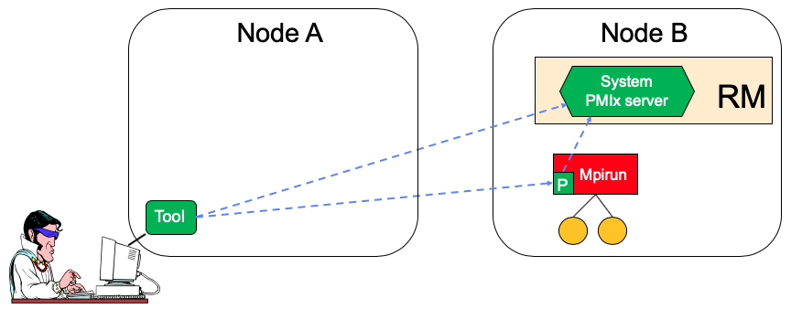
Tool Connections: Remote
Query local server for URI
Reconnect to returned URI
System and job-level servers
Compute from configuration, given target node
MCA param for static socket of system servers
Spawn proxy to scan
Assumes permissions and mechanism for spawn

Slide 103
General Capabilities
Query RM or launcher for support
Mechanisms for “hold” and “release”
Daemon co-launch capabilities
IO forwarding support
Specify app release mechanism
PMIx event, signal, …
Register for events
Termination of debugger job and/or daemons
Termination of app job and/or procs
Request debugger start on event from app

Slide 104
Debugger/Tool Features
Co-launch/co-location of daemons
At initial app spawn
Co-launch
Upon attach
Spawn w/co-location
Launch control
Stop-on-exec, stop-in-init, stop-in-app
Release method to be used
Forwarding of IO
To/from debugger daemons
To/from app being debugged
Query app info
Global and local proctable
Application internal metadata
Direct/indirect launch support
Forward, set/unset/modify envars (e.g., LD_PRELOAD)
Launcher directives
Modify local fork/exec agent
Replace launcher daemons
Local launcher fork/exec option
If PMIx_Spawn not available or if desired

Slide 105
Direct Launch
RM
RM
PMIx
Server
PMIx
Server
Dbgr
Dmn
Proc
Proc
Co-launch
Two-stage launch

Slide 106
Indirect Launch
RM
RM
PMIx
Server
PMIx
Server
PMIx_Spawn
mpiexec
PMIx
Server
PMIX_LAUNCHER_PAUSE_FOR_TOOL
fork/exec

Slide 107
Indirect Launch
RM
RM
PMIx
Server
PMIx
Server
mpiexec
Pass directives, application description
PMIx
Server
Launch
Directives

Slide 108
Indirect Launch
RM
RM
PMIx
Server
PMIx
Server
PMIx_Spawn
mpiexec
ssh
mpid
PMIx
Server
PMIx
Server
Dbgr
Dmn
Co-launch
Two-stage launch
Proc
Proc

Slide 109
Attach to Running Job
RM
RM
PMIx
Server
PMIx
Server
mpiexec
mpid
PMIx
Server
PMIx
Server
Dbgr
Dmn
Proc
Proc

Slide 110
Attach to Running Job
RM
RM
PMIx
Server
PMIx
Server
Launch
Daemons
mpiexec
mpid
PMIx
Server
PMIx
Server
Dbgr
Dmn
Proc
Proc
Direct or Indirect Launch

Slide 111
Assigning Procs->Daemons
Query:
Local proctable
Local rank
RM
RM
PMIx
Server
PMIx
Server
Dbgr
Dmn
Query global
proctable
Proc
Proc
PMIX_DEBUG_JOB
Assigned in launch data

Slide 112
Assigning Procs->Daemons
RM
RM
PMIx
Server
PMIx
Server
Query:
Local proctable
Local rank
mpiexec
mpid
PMIx
Server
PMIx
Server
Dbgr
Dmn
PMIX_DEBUG_JOB
Assigned in launch data
Proc
Proc

Slide 113
Assigning Procs->Daemons
RM
RM
PMIx
Server
PMIx
Server
Query:
Local proctable
Local rank
mpiexec
mpid
PMIx
Server
PMIx
Server
Dbgr
Dmn
PMIX_DEBUG_JOB
Assigned in launch data
Proc
Proc

Slide 114
Forwarding of Output
RM
RM
PMIx
Server
stdout
stderr
PMIx
Server
Dbgr
Dmn
Proc
Proc
Sent via PMIx

Slide 115
Forwarding Stdin
RM
RM
PMIx
Server
stdin
PMIx
Server
PMIx Client
Collects
Dbgr
Dmn
Proc
Proc
Sent via PMIx
Tool
Collects

Slide 116
Forwarding Stdin
RM
RM
PMIx
Server
PMIx
Server
stdin
PMIx Client
Collects
mpiexec
mpid
Sent via PMIx
PMIx
Server
PMIx
Server
Dbgr
Dmn
Tool
Collects
Proc
Proc

Slide 117
Wrap-Up
Covered a lot of ground
Primary focus on scheduler
Implementation status
Client & basic server: in production
Scheduler & fabric: alpha
Storage: in definition
Expected completion
Release v4.0 in 2Q2020
Thank You!

